Slide 1
Internet Basics

Slide 2
Internet : A set of interconnected networks ...
The Internet is a global network of billions of computers and other electronic devices. With the Internet, it's possible to access almost any information, communicate with anyone else in the world, and do much more.

Slide 3
Applications of Internet
Large volume of Information: Internet can be used to collect information from around the world. This information could relate to education, medicine, literature, software, computers, business, entertainment, friendship, tourism, and leisure. People can search for information by visiting the home page of various search engines such as Google, Yahoo, Bing, etc.
News and Journals: All the newspapers, magazines and journals of the world are available on the Internet. With the introduction of broadband and advanced mobile telecommunication technologies such as 3G (third generation) and 4G (fourth generation), the speed of internet service has increased tremendously. A person can get the latest news about the world in a matter of few seconds.
Electronic Mode of Communication: Internet has given the most exciting mode of communication to all. We can send an E-mail (the short form of Electronic Mailing System) to all the corners of the world.

Slide 4
Applications of Internet
Social Networking: People can connect with old friends on social networking sites. They can even chat with them when they are online. Social networking sites also allow us to share pictures with others. We can share pictures with our loved ones, while we are on a vacation. People are even concluding business deals over these social networking sites such as Facebook.
Online Banking (Net-Banking): The use of internet can also be seen in the field of banking transactions. Many banks such as HSBC, SBI, Axis Bank, Hdfc Bank, etc. offers online banking facilities to its customers. They can transfer funds from one account to another using the net-banking facility.
E-commerce: Internet is also used for carrying out business operations and that set of operations is known as Electronic Commerce (E-commerce). Flipkart is the largest e-commerce company in India. The rival, Amazon, is giving stiff competition to Flipkart.
Chatting: There are many chatting software that can be used to send and receive real-time messages over the internet. We can chat with our friend and relatives using any one of the chatting software.

Slide 5
Applications of Internet
Mobile commerce: Mobile commerce (also M-Commerce) refers to the commercial transaction that takes place over the mobile internet. Using the mobile internet technology, many companies have introduced mobile version of websites and mobile apps, to promote and sell their products. Customers can simply browse several through the products and buy online through mobile internet.
Mobile wallet: Many companies offer the service of mobile wallet to its customers. Users must have a smart-phone and internet connection to use this service. Users can pay an amount into their mobile wallet, which they can use to make online payment such as bill payments, recharges, etc.
Entertainment: Apart from a major source of knowledge and information, the utility of Internet in the field of entertainment cannot be undermined. We can visit various video sites and watch movies and serials at our convenient time.
Technology of the Future: Internet is the technology of future. In the times to come, offices would be managed at distant places through Internet.

Slide 6
Types of Internet Services....
The type of Internet service you choose will largely depend on which Internet service providers (ISPs) serve your area, along with the types of service they offer. Here are some common types of Internet service.
Dial-up: This is generally the slowest type of Internet connection, and you should probably avoid it unless it is the only service available in your area. Dial-up Internet uses your phone line, so unless you have multiple phone lines you will not be able to use your landline and the Internet at the same time.
DSL: DSL service uses a broadband connection, which makes it much faster than dial-up. DSL connects to the Internet via a phone line but does not require you to have a landline at home. And unlike dial-up, you'll be able to use the Internet and your phone line at the same time.
Contd.....

Slide 7
Types of Internet Services....
Cable: Cable service connects to the Internet via cable TV, although you do not necessarily need to have cable TV in order to get it. It uses a broadband connection and can be faster than both dial-up and DSL service; however, it is only available where cable TV is available.
Satellite: A satellite connection uses broadband but does not require cable or phone lines; it connects to the Internet through satellites orbiting the Earth. As a result, it can be used almost anywhere in the world, but the connection may be affected by weather patterns. Satellite connections are also usually slower than DSL or cable.
3G and 4G: 3G and 4G service is most commonly used with mobile phones, and it connects wirelessly through your ISP's network. However, these types of connections aren't always as fast as DSL or cable. They will also limit the amount of data you can use each month, which isn't the case with most broadband plans.

Slide 8
Hardware Needed for Internet Connection....
MODEM:
Once you have your computer, you really don't need much additional hardware to connect to the Internet. The primary piece of hardware you need is a modem.
The type of Internet access you choose will determine the type of modem you need. Dial-up access uses a telephone modem, DSL service uses a DSL modem, cable access uses a cable modem, and satellite service uses a satellite adapter. Your ISP may give you a modem—often for a fee—when you sign a contract, which helps ensure that you have the right type of modem. However, if you would prefer to shop for a better or less expensive modem, you can choose to buy one separately.
Router (a wireless router)
A router is a hardware device that allows you to connect several computers and other devices to a single Internet connection, which is known as a home network. Many routers are wireless, which allows you to create a home wireless network, commonly known as a Wi-Fi network.
You don't necessarily need to buy a router to connect to the Internet. It's possible to connect your computer directly to your modem using an Ethernet cable. Also, many modems include a built-in router, so you have the option of creating a Wi-Fi network without buying extra hardware.

Slide 9
Internet Domain.....
Domain names are used to identify one or more IP addresses. For example, the domain name microsoft.com represents about a dozen IP addresses. Domain names are used in URLs to identify particular Web pages. For example, in the URL http://www.pcwebopedia.com/index.html, the domain name is pcwebopedia.com.
Every domain name has a suffix that indicates which top level domain (TLD) it belongs to. There are only a limited number of such domains. For example:
gov - Government agencies
edu - Educational institutions
org - Organizations (nonprofit)
mil - Military
com - commercial business
net - Network organizations
Because the Internet is based on IP addresses, not domain names, every Web server requires a Domain Name System (DNS) server to translate domain names into IP addresses.

Slide 10
TCP/IP
TCP/IP is not really a protocol, but a set of protocols – a protocol stack, as it is most commonly called. Its name, for example, already refers to two different protocols, TCP (Transmission Control Protocol) and IP (Internet Protocol). There are several other protocols related to TCP/IP like FTP, HTTP, SMTP and UDP
Networks can be completely different Ethernet, ATM, modem etc. TCP/IP is what links them
TCP/IP hides the details as much as possible

Slide 11
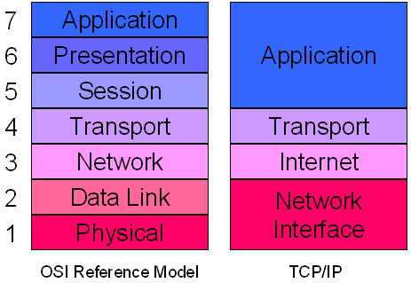
TCP/IP
Four Layers of TCP/IP
Application layer
Transport layer
Network layer
Host to Network layer

Slide 12
IP Address
An IP address, short for Internet Protocol address, is an identifying number for a piece of network hardware. Having an IP address allows a device to communicate with other devices over an IP-based network like the internet.

Slide 13
IP Address
private IP addresses
private IP addresses are used "inside" a network, like the one you probably run at home. These types of IP addresses are used to provide a way for your devices to communicate with your router and all the other devices in your private network. Private IP addresses can be set manually or assigned automatically by your router.
public IP addresses
Public IP addresses are used on the "outside" of your network and are assigned by your ISP. It's the main address that your home or business network uses to communicate with the rest of the networked devices around the world (i.e. the internet). It provides a way for the devices in your home, for example, to reach your ISP, and therefore the outside world, allowing them to do things like access websites and communicate directly with other people's computers.

Slide 14
IP Address
Static IP addresses
Dynamic IP addresses
Both private IP addresses and public IP addresses are either dynamic or static, which means that, respectively, they either change or they don't.
An IP address that is assigned by a DHCP (Dynamic Host Configuration Protocol is a protocol used to provide quick, automatic, and central management for the distribution of IP addresses within a network.) server is a dynamic IP address. If a device does not have DHCP enabled or does not support it then the IP address must be assigned manually, in which case the IP address is called a static IP address.

Slide 15
There are two versions of IP:
IPv4 (Outdated)
provide over 4 billion unique IP addresses (2³²)
IPv4 displays addresses as a 32-bit numerical number written in decimal format, like 207.241.148.80 or 192.168.1.1
IPv6 (Upgraded Version)
supports a whopping 340 trillion, trillion, trillion addresses (2¹²⁸)
Because there are trillions of possible IPv6 addresses, they must be written in hexadecimal to display them, like 3ffe:1900:4545:3200:f8ff:fe21:67cf.

Slide 16
IP Address Classes
The Internet community originally defined five address classes to accommodate networks of varying sizes. Microsoft TCP/IP supports class A, B, and C addresses assigned to hosts. The class of address defines which bits are used for the network ID and which bits are used for the host ID. It also defines the possible number of networks and the number of hosts per network.
Class | Address Range | Supports
Class A | 1.0.0.1 to 126.255.255.254 | Supports 16 million hosts on each of 127 networks.
Class B | 128.1.0.1 to 191.255.255.254 | Supports 65,000 hosts on each of 16,000 networks.
Class C | 192.0.1.1 to 223.255.254.254 | Supports 254 hosts on each of 2 million networks.
Class D | 224.0.0.0 to 239.255.255.255 | Reserved for multicast groups.
Class E | 240.0.0.0 to 254.255.255.254 | Reserved for future use, or Research and Development Purposes.

Slide 17
IP Address
Class A
Class A addresses are assigned to networks with a very large number of hosts. The high-order bit in a class A address is always set to zero. The next seven bits (completing the first octet) complete the network ID. The remaining 24 bits (the last three octets) represent the host ID. This allows for 126 networks and 16,777,214 hosts per network.
Network ID |  |  |  |  |  |  |  | HOST ID
0 |  |  |  |  |  |  |  | 8 |  | 31
0

Slide 18
IP Address
Class B
Class B addresses are assigned to medium-sized to large-sized networks. The two high-order bits in a class B address are always set to binary 1 0. The next 14 bits (completing the first two octets) complete the network ID. The remaining 16 bits (last two octets) represent the host ID. This allows for 16,384 networks and 65,534 hosts per network.
Network ID |  |  |  |  |  |  |  | HOST ID
0 |  |  |  |  |  |  | 15 | 16 |  | 31
1 | 0

Slide 19
IP Address
Class C
Class C addresses are used for small networks. The three high-order bits in a class C address are always set to binary 1 1 0. The next 21 bits (completing the first three octets) complete the network ID. The remaining 8 bits (last octet) represent the host ID. This allows for 2,097,152 networks and 254 hosts per network.
Network ID |  |  |  |  |  |  |  | HOST ID
0 |  |  |  |  |  |  | 23 | 24 |  | 31
1 | 1 | 0

Slide 20
IP Address
Class D
Class D addresses are reserved for IP multicast addresses. The four high-order bits in a class D address are always set to binary 1 1 1 0. The remaining bits are for the address that interested hosts recognize. Microsoft supports class D addresses for applications to multicast data to multicast-capable hosts on an internetwork.
A multicast address, also called a group address, is a single IP address for a set of hosts that are joined in a multicasting group. An IP (Internet protocol) address is a unique numeric identifier for a computer or other device on a TCP/IP (transmission control protocol/Internet protocol) network
Class E
Class E is an experimental address that is reserved for future use. The high-order bits in a class E address are set to 1111.

Slide 21
Layer 4. Application Layer:
Programs talk to the Application layer. On the Application layer you will find Application protocols such as SMTP (for e-mail), FTP (for file transfer) and HTTP (for web browsing). Each kind of program talks to a different Application protocol, depending on the program purpose
Application layer is the top most layer of four layer TCP/IP model.
Application layer is present on the top of the Transport layer.
The application layer is concerned with providing network services to applications.
Application layer defines TCP/IP application protocols and how host programs interface with Transport layer services to use the network.

Slide 22
Transport Layer
After processing the program request, the protocol on the Application layer will talk to another protocol from the Transport layer, usually TCP. This layer is in charge of getting data sent by the upper layer, dividing them into packets and sending them to the layer below, Internet. Also, during data reception, this layer is in charge of putting the packets received from the network in order (because they can be received out-of-order) and also checking if the contents of the packets are intact.
Transport Layer is the third layer of the four layer TCP/IP model. The position of the Transport layer is between Application layer and Internet layer.
The purpose of Transport layer is to permit devices on the source and destination hosts to carry on a conversation. Transport layer defines the level of service and status of the connection used when transporting data.
The main protocols included at Transport layer are TCP (Transmission Control Protocol) and UDP (User Datagram Protocol).

Slide 23
Layer 2. Internet Layer
On the Internet layer we have the IP (Internet Protocol), which gets the packets received from the Transport layer and adds virtual address information, i.e., adds the address of the computer that is sending data and the address of the computer that will receive this data. These virtual addresses are called IP addresses. Then the packet is sent to the lower layer, Network Interface. On this layer packets are called datagrams.
Internet Layer is the second layer of the four layer TCP/IP model.
The position of Internet layer is between Network Access Layer and Transport layer.
Internet layer pack data into data packets known as IP datagrams, which contain source and destination address (logical address or IP address) information that is used to forward the datagrams between hosts and across networks. The Internet layer is also responsible for routing of IP datagrams.
Contd.....

Slide 24
Layer 2: Internet Layer...
Packet switching network depends upon a connectionless internetwork layer. This layer is known as Internet layer.
Its job is to allow hosts to insert packets into any network and have them to deliver independently to the destination. At the destination side data packets may appear in a different order than they were sent. It is the job of the higher layers to rearrange them in order to deliver them to proper network applications operating at the Application layer.
The main protocols included at Internet layer are IP (Internet Protocol), ICMP (Internet Control Message Protocol), ARP (Address Resolution Protocol), RARP (Reverse Address Resolution Protocol) and IGMP (Internet Group Management Protocol).

Slide 25
Layer 1. Network Access Layer
The Network Interface will get the packets sent by the Internet layer and send them over the network (or receive them from the network, if the computer is receiving data). What is inside this layer will depend on the type of network your computer is using.
Nowadays almost all computers use a type of network called Ethernet (which is available in several different speed grades; wireless networks are also Ethernet networks)
Packets transmitted over the network are called frames.
Network Access Layer is the first layer of the four layer TCP/IP model.
Network Access Layer defines details of how data is physically sent through the network, including how bits are electrically or optically signalled by hardware devices that interface directly with a network medium, such as coaxial cable, optical fibre, or twisted pair copper wire.
The protocols included in Network Access Layer are Ethernet, Token Ring, FDDI, X.25, Frame Relay etc.

Slide 26
TCP/IP is a set of protocols that deals with layers 3 to 7 from the OSI reference model, while Ethernet is a set of protocols that deals with layers 1 and 2 from the OSI reference model – meaning Ethernet deals with the physical aspect of the data transmission.
Ethernet has three layers: Logic Link Control (LLC), Media Access Control (MAC) and Physical Layer.
The Logic Link Control layer (LLC) is in charge of adding information of which protocol on the Internet layer delivered data to be transmitted, so when receiving a frame from the network this layer on the receiving computer has to know to which protocol from the Internet layer it should deliver data.
The Media Access Control layer (MAC) is in charge of assembling the frame that will be sent over the network. This layer is in charge of adding the source MAC address and the target MAC address
The Physical layer is in charge of converting the frame generated by the MAC layer into electricity (if a cabled network is being used) or into electromagnetic waves (if a wireless network is being used).

Slide 27
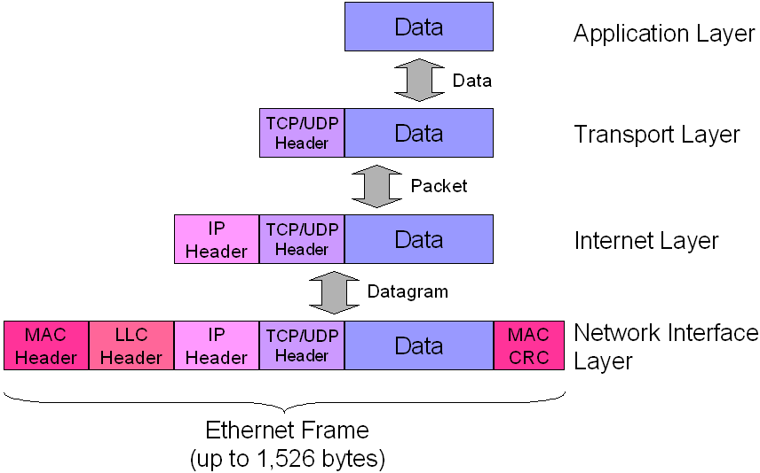

Slide 28
Virtual vs Physical AdDress
Virtual address: On TCP/IP networks each computer is identified with a unique virtual address, called IP address. The Internet layer is in charge of adding a header to the data packet received from the Transport layer where, among other control data, it will add the source IP address and the target IP address
Physical Address: The network card of each computer has a physical address assigned to it. This address is written on the network card read-only memory (ROM) and is called MAC address. So on a local area network whenever computer A wants to send data to computer B, it will have to know computer’s B MAC address. While on a small local area network computers can easily discover each other’s MAC address, this isn’t an easy task on a global network like the Internet.

Slide 29
Routing
Routing is the path that a data packet should use in order to arrive at destination. When requesting data from an Internet server, for example, this data passes through several locations (called routers) before arriving at your computer.
If you want to see this in action, Then on the command prompt type in tracert www.google.com.
The output will be the path between your computer and Google’s web server.
Each router in the middle of the road is also called hop.

