Slide 1
Artificial Intelligence
M.Sc. IT IV SEM
UNIT-III
By : Dr. Vipin Kumar Jain
Assistant Professor
Department of Computer Science
S.S. Jain Subodh P.G. College

Slide 2
Semantic Network

Slide 3
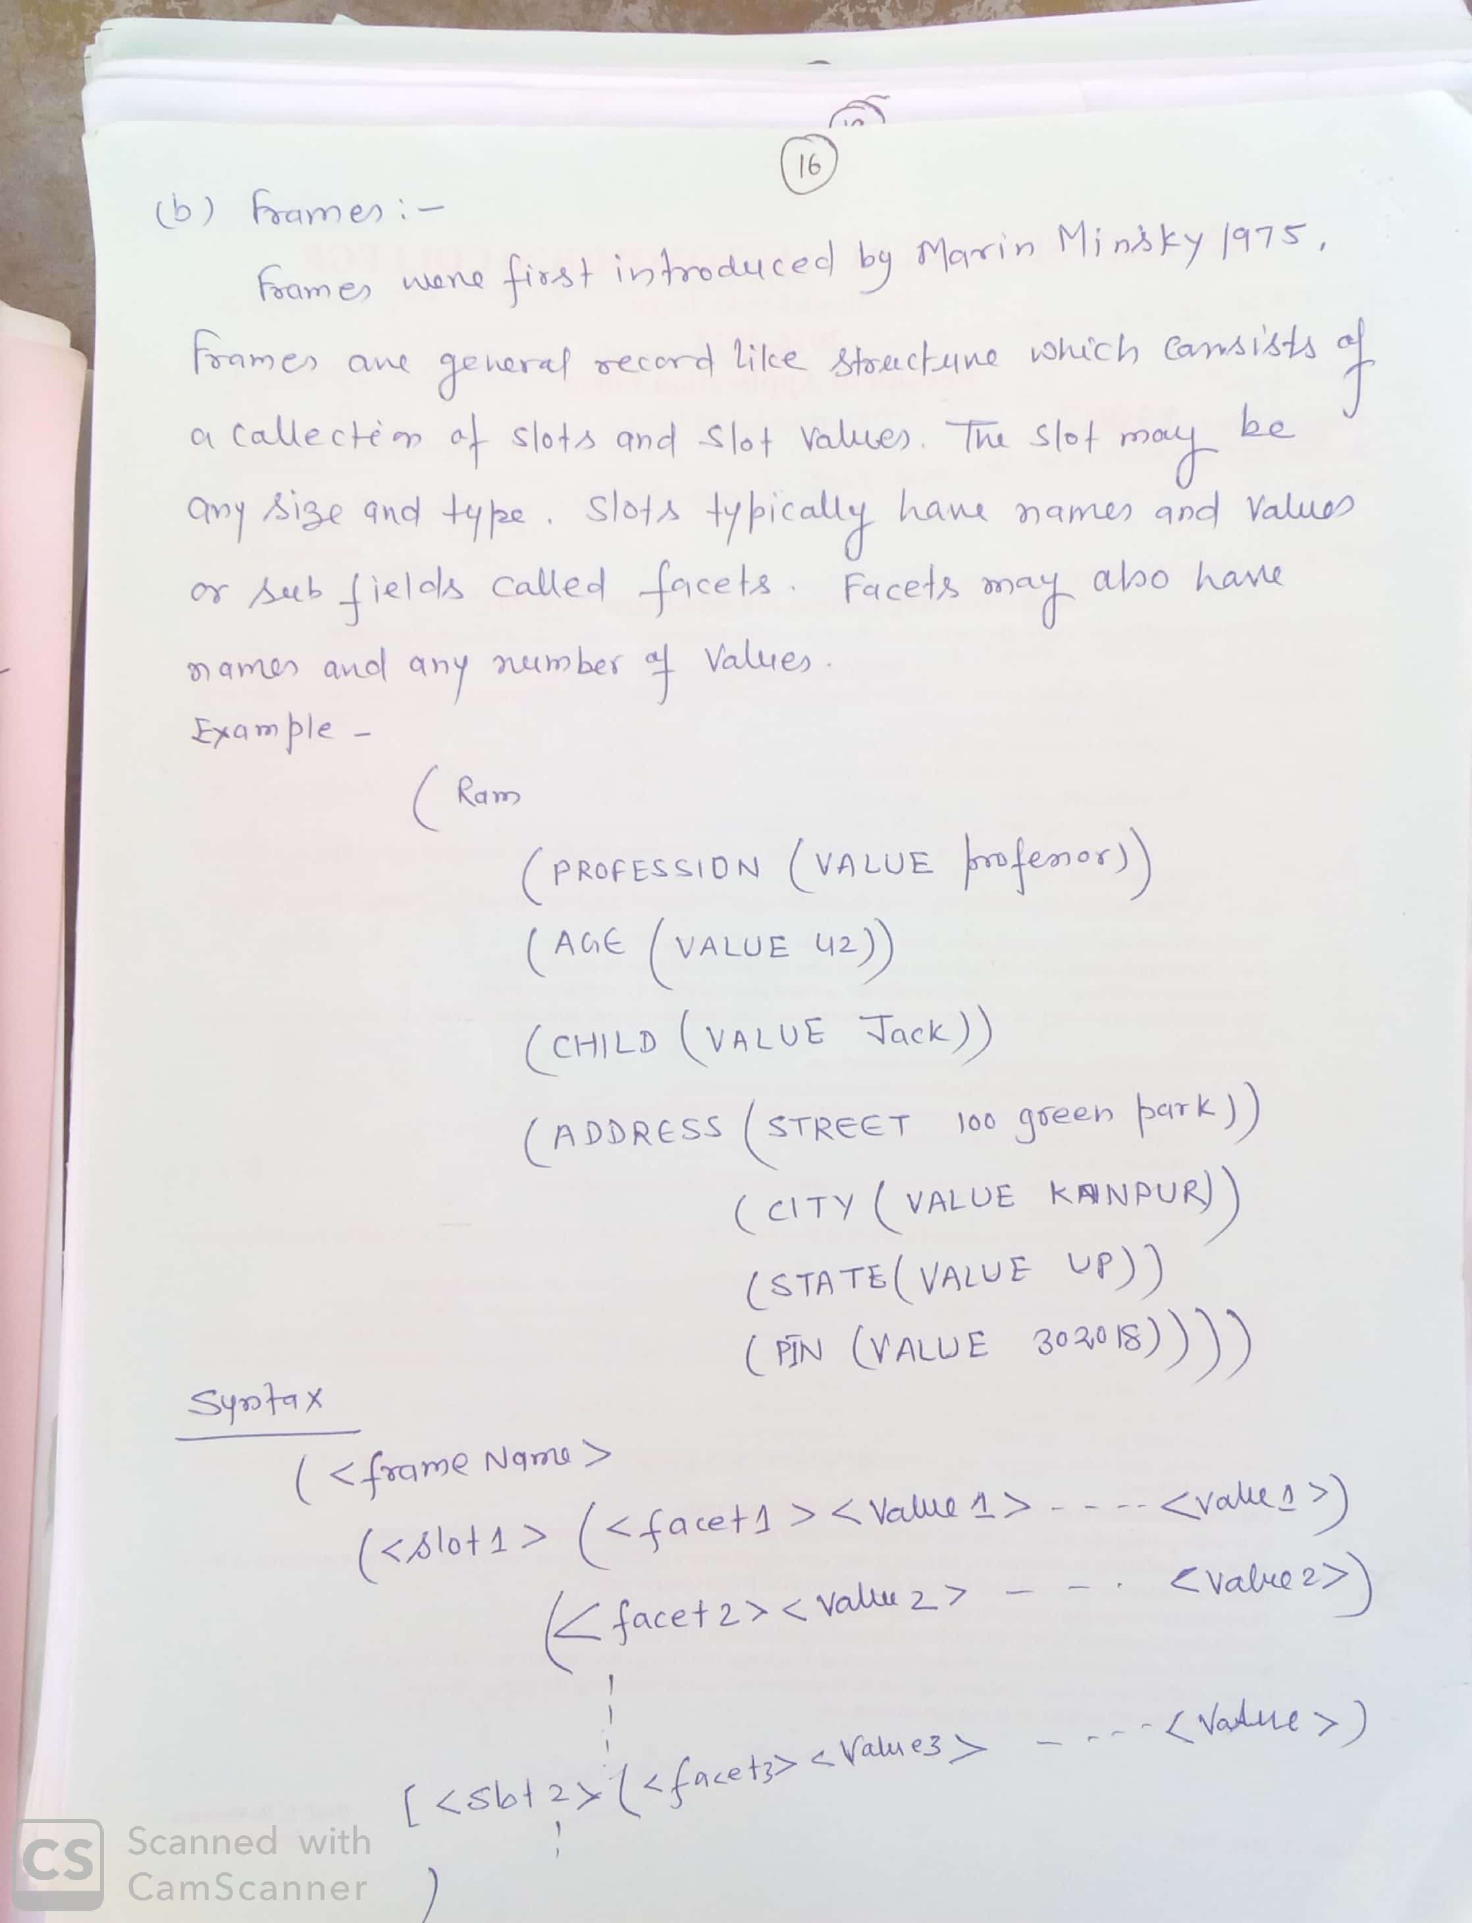
Frames :

Slide 4
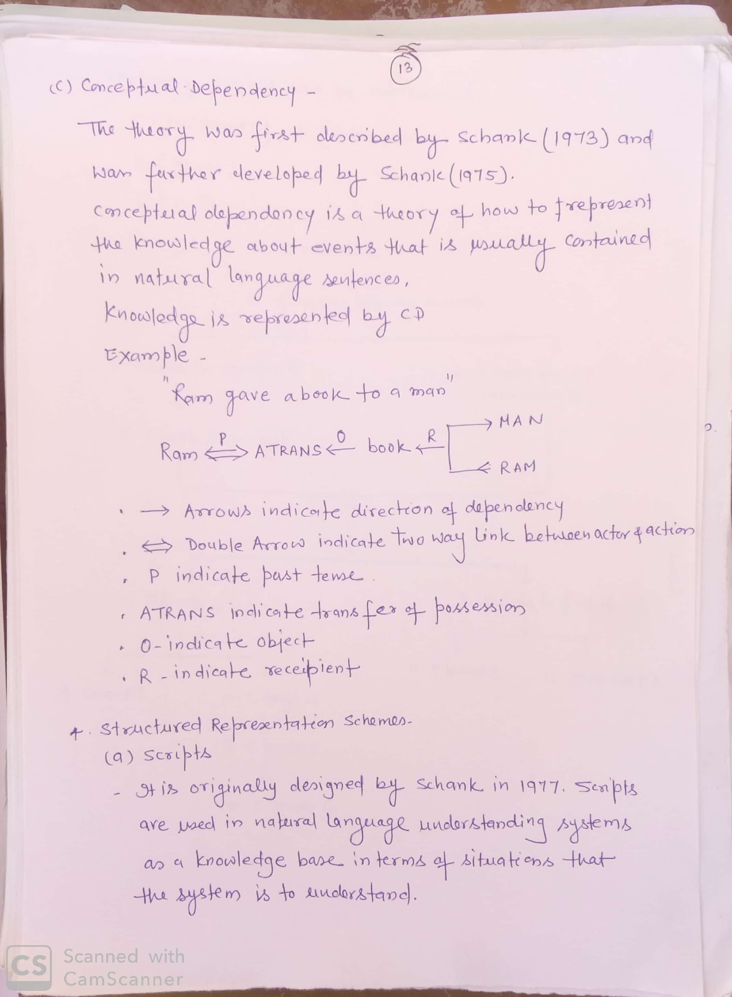
Conceptual Dependency

Slide 5
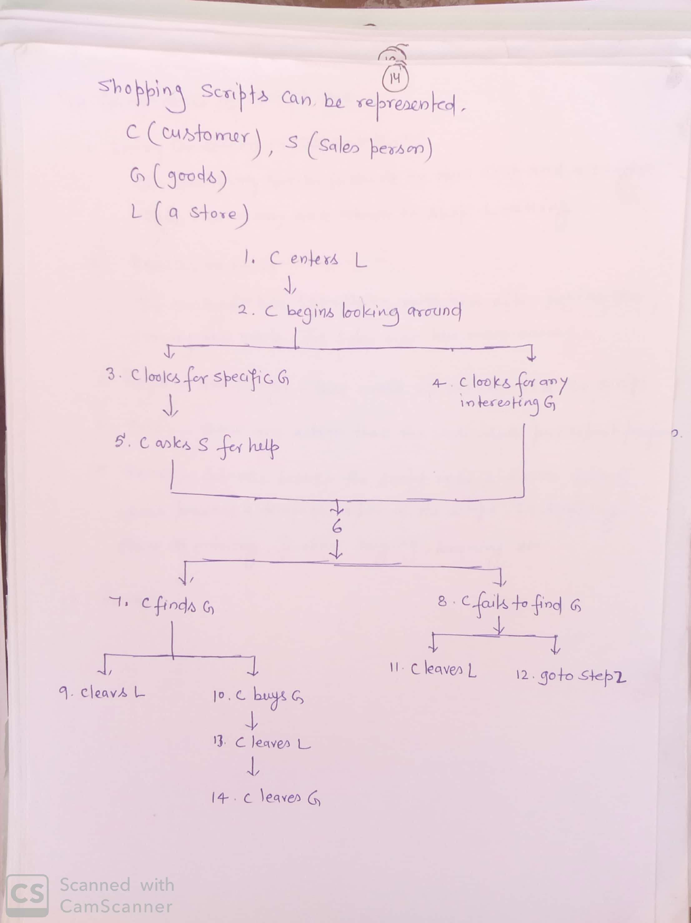
Scripts

Slide 6
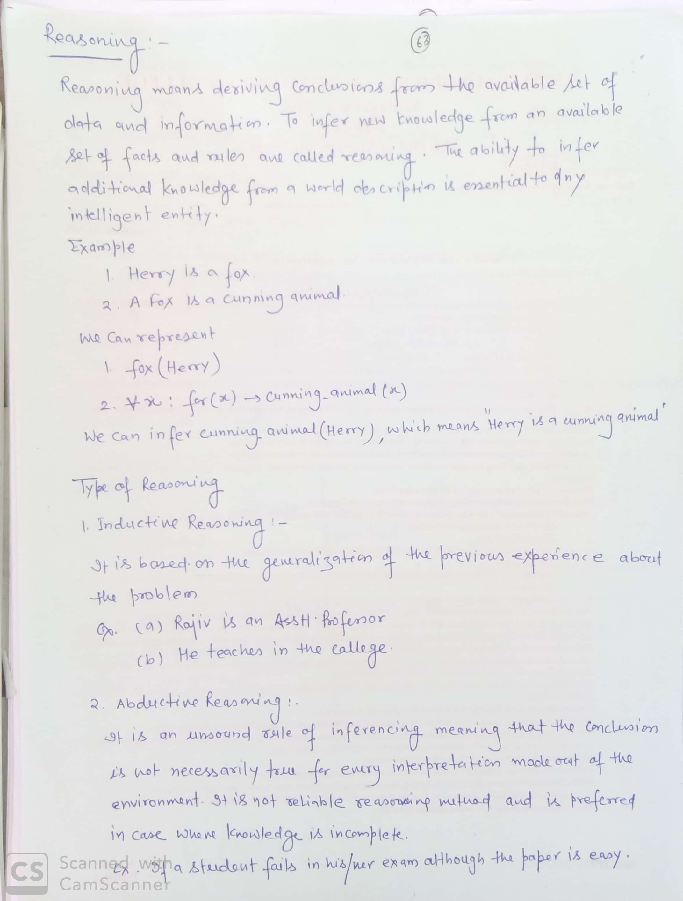
Reasoning

Slide 7
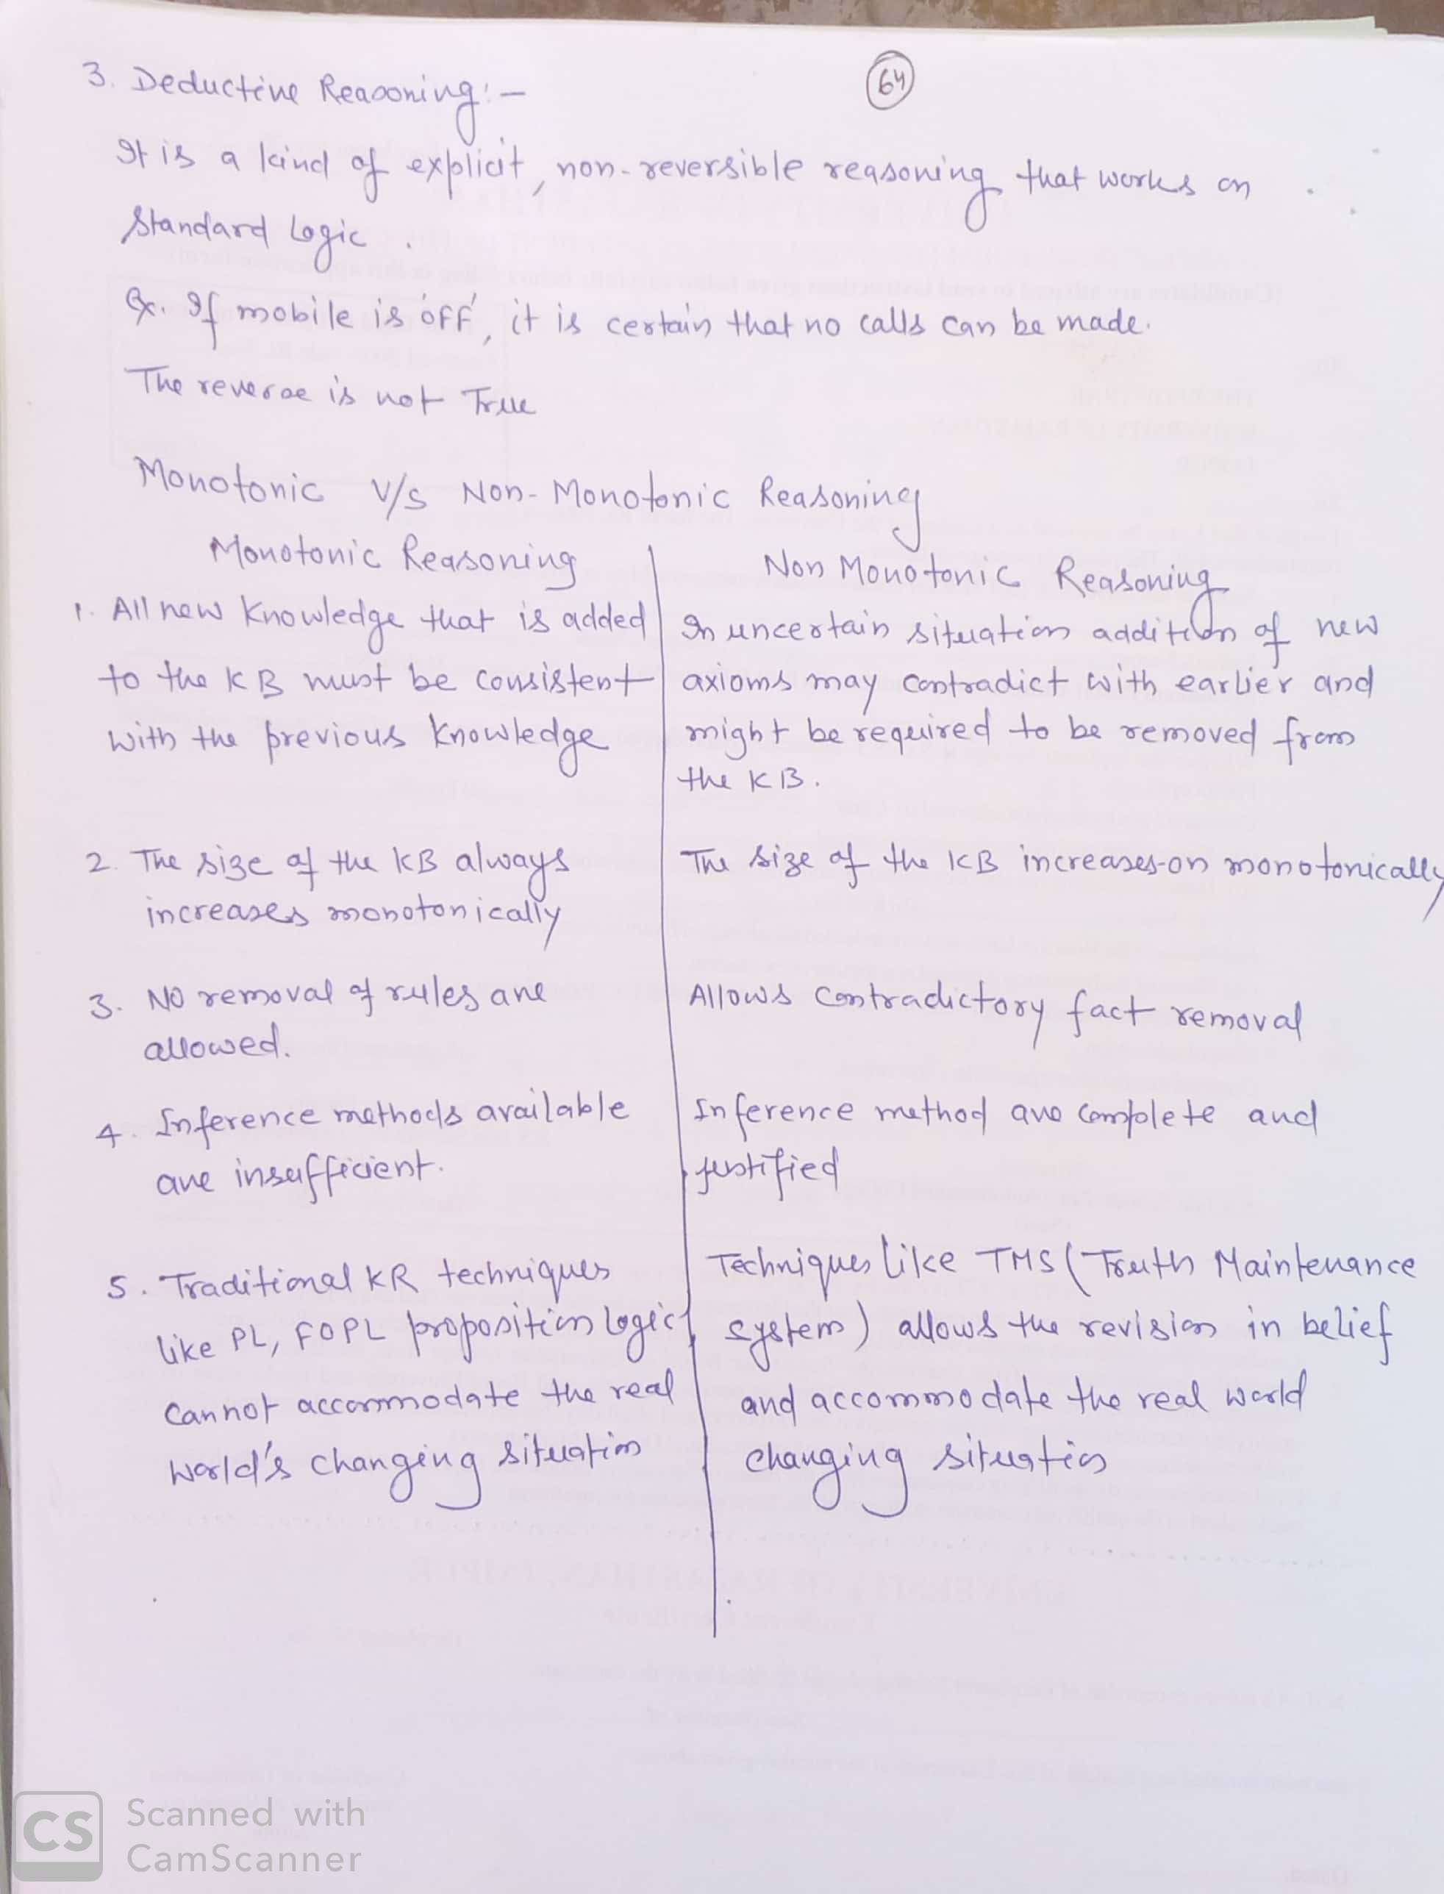
Default Reasoning

Slide 8
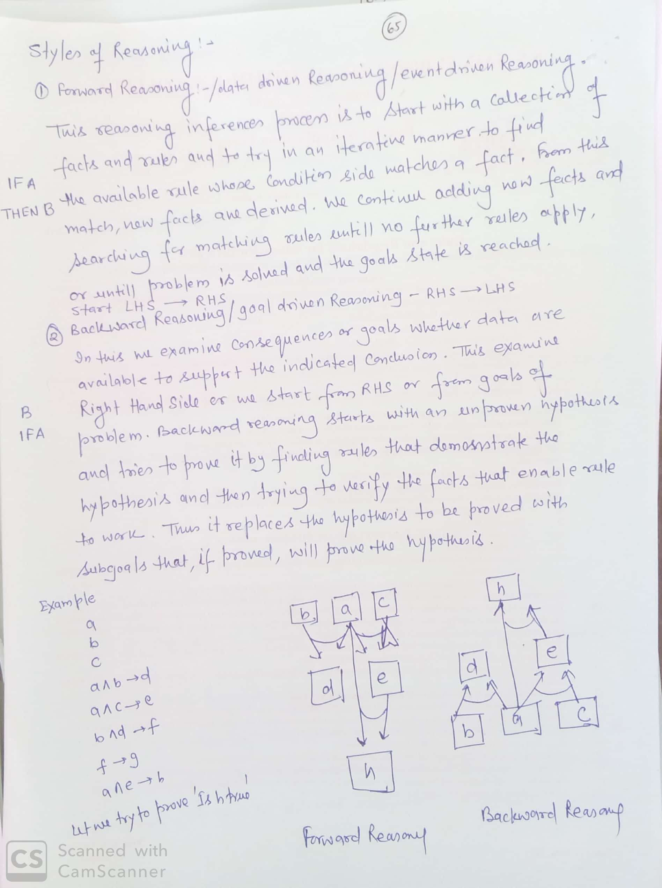
Styles of Reasoning

Slide 9
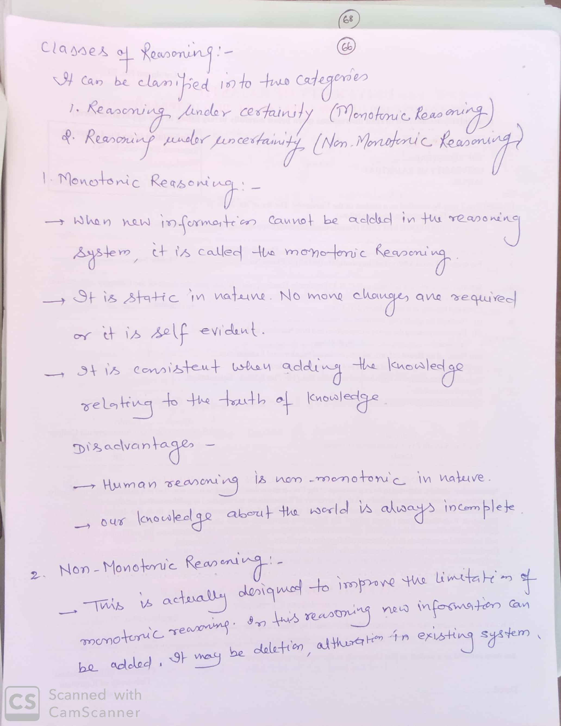
Monotonic and Non- Monotonic Reasoning

Slide 10
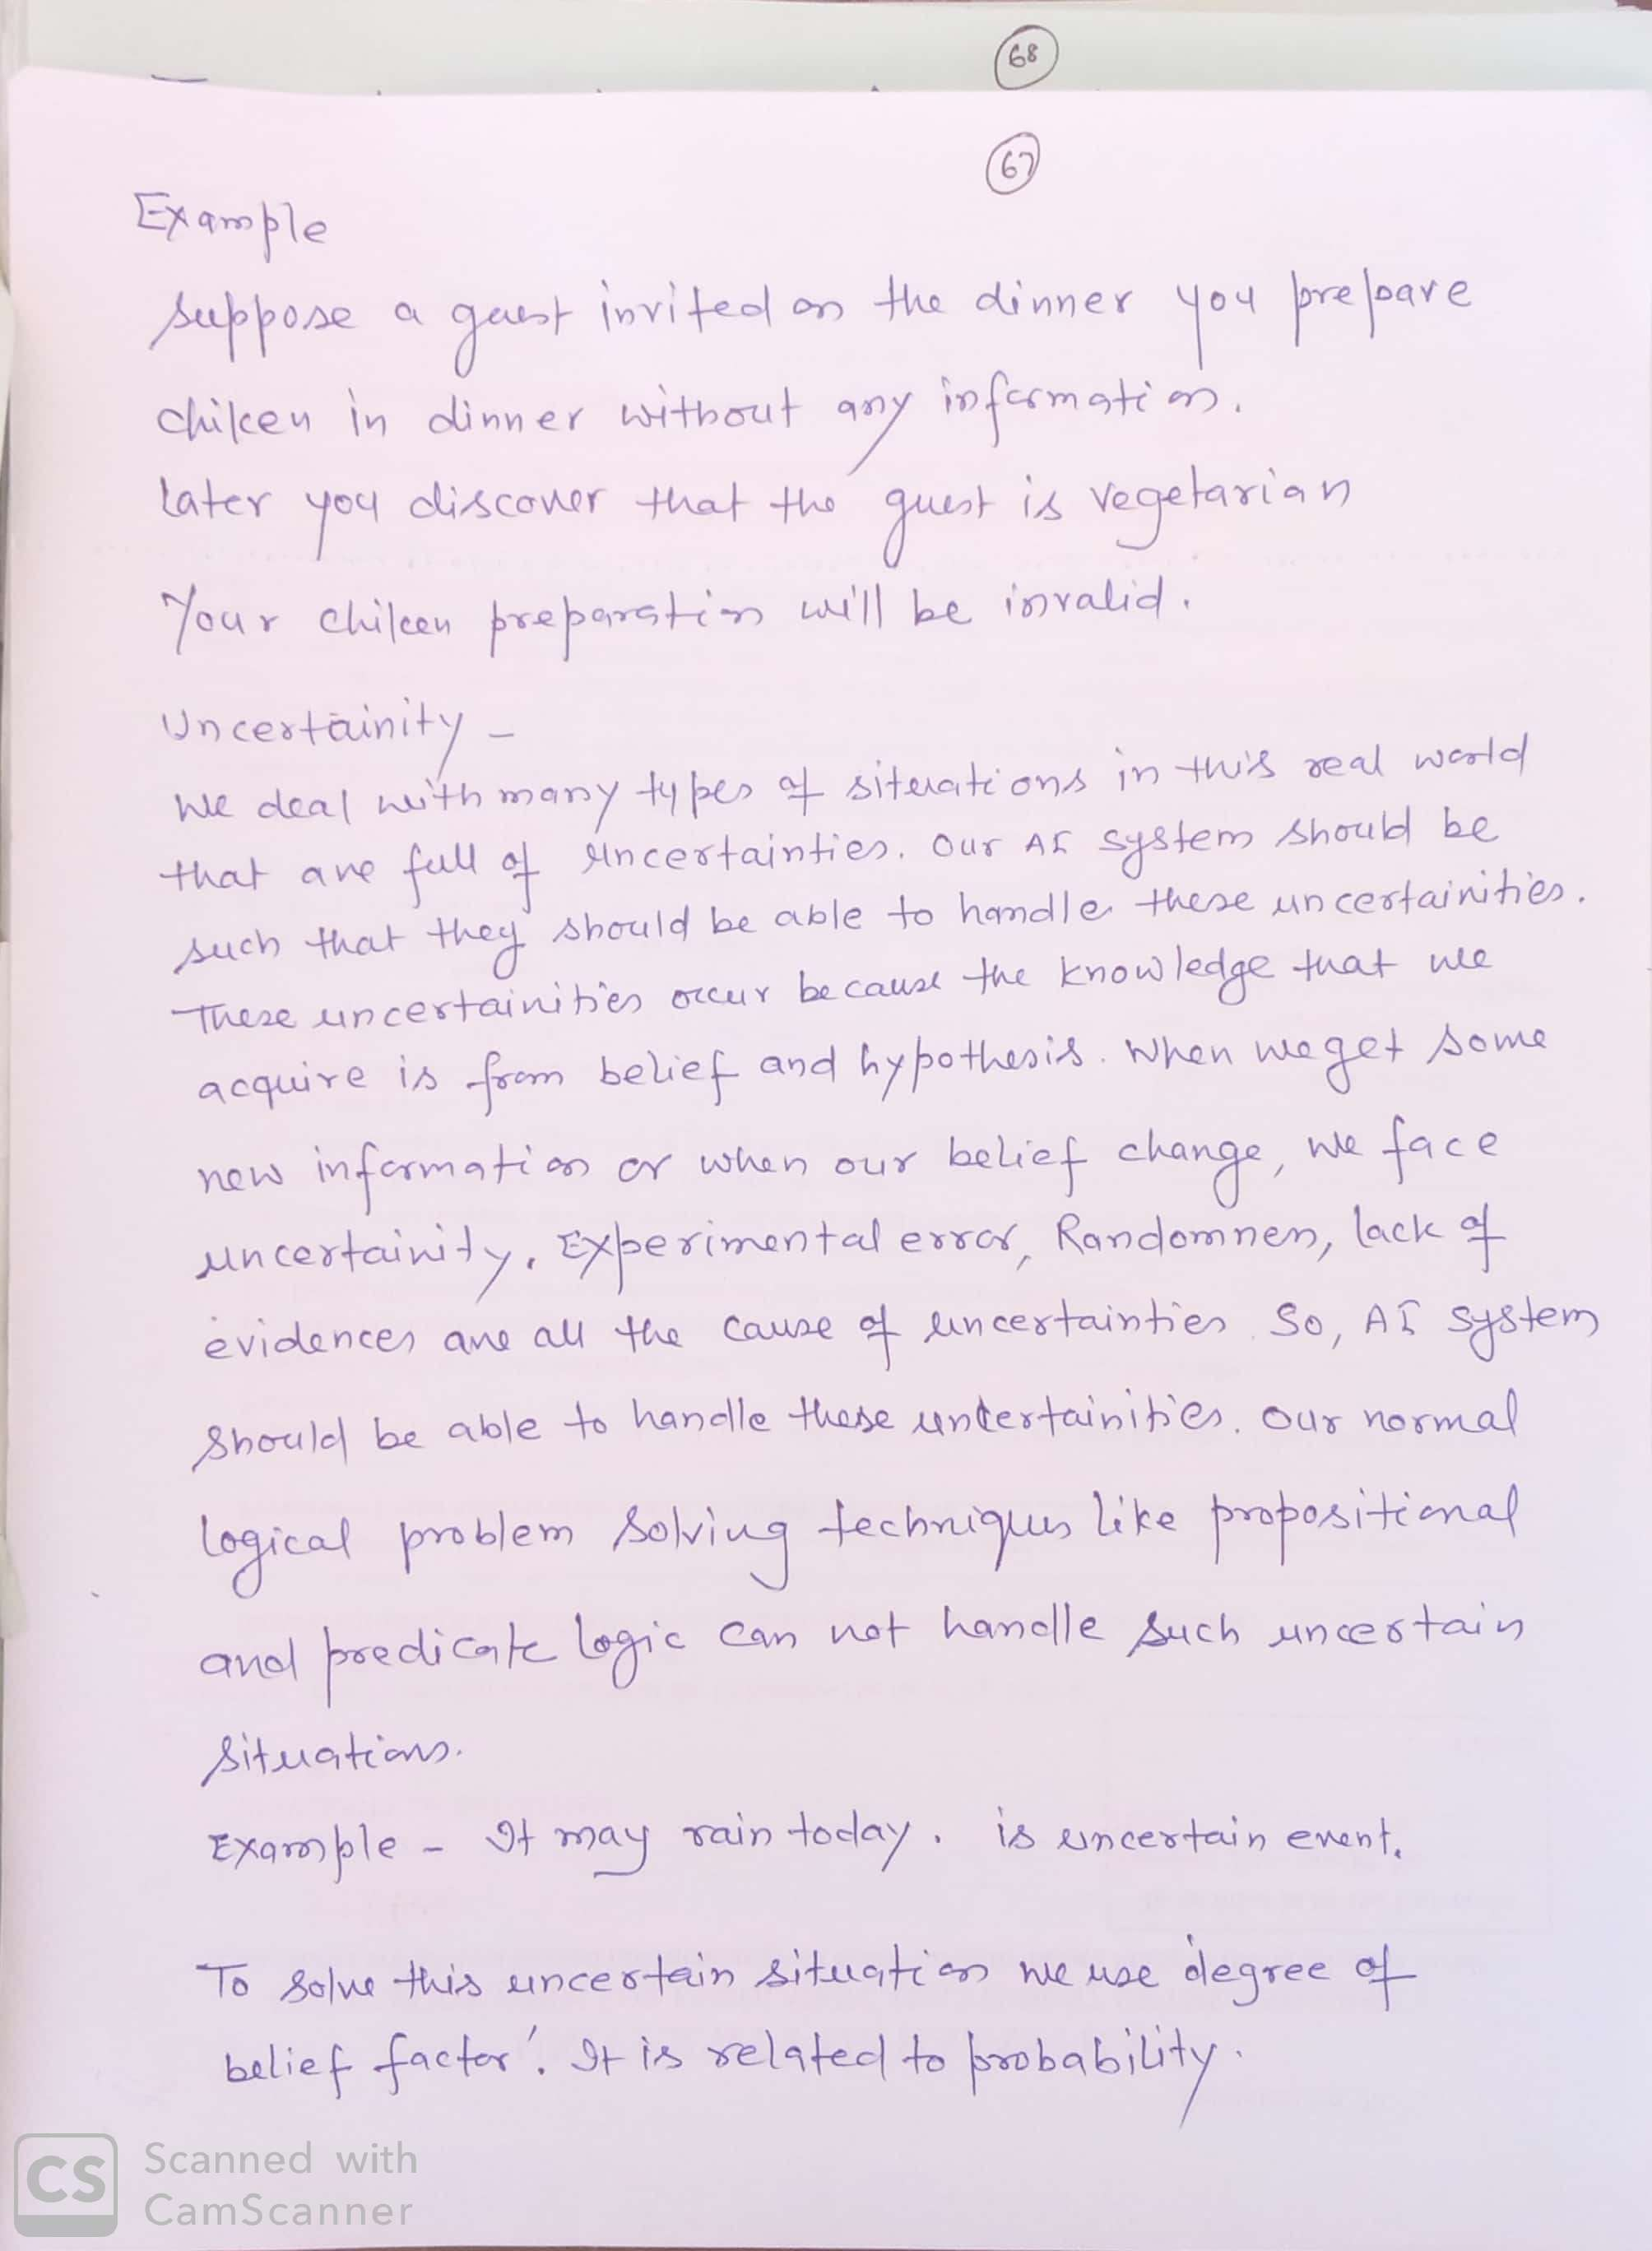

Slide 12
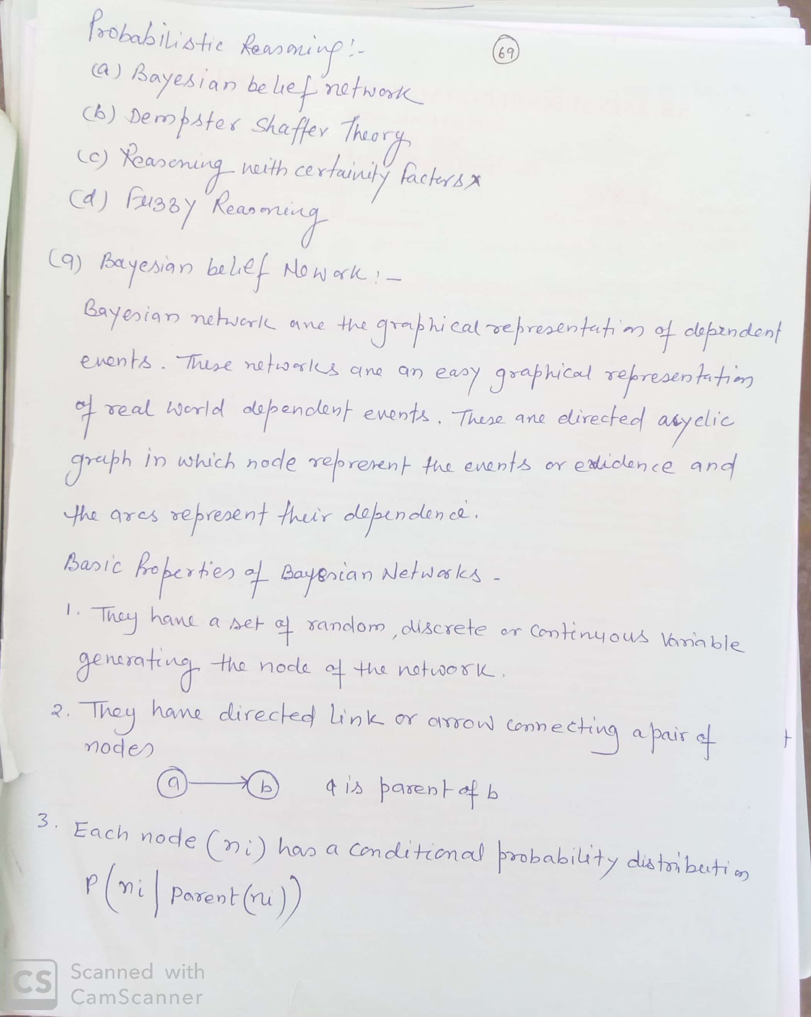
Probabilistic Reasoning

Slide 13
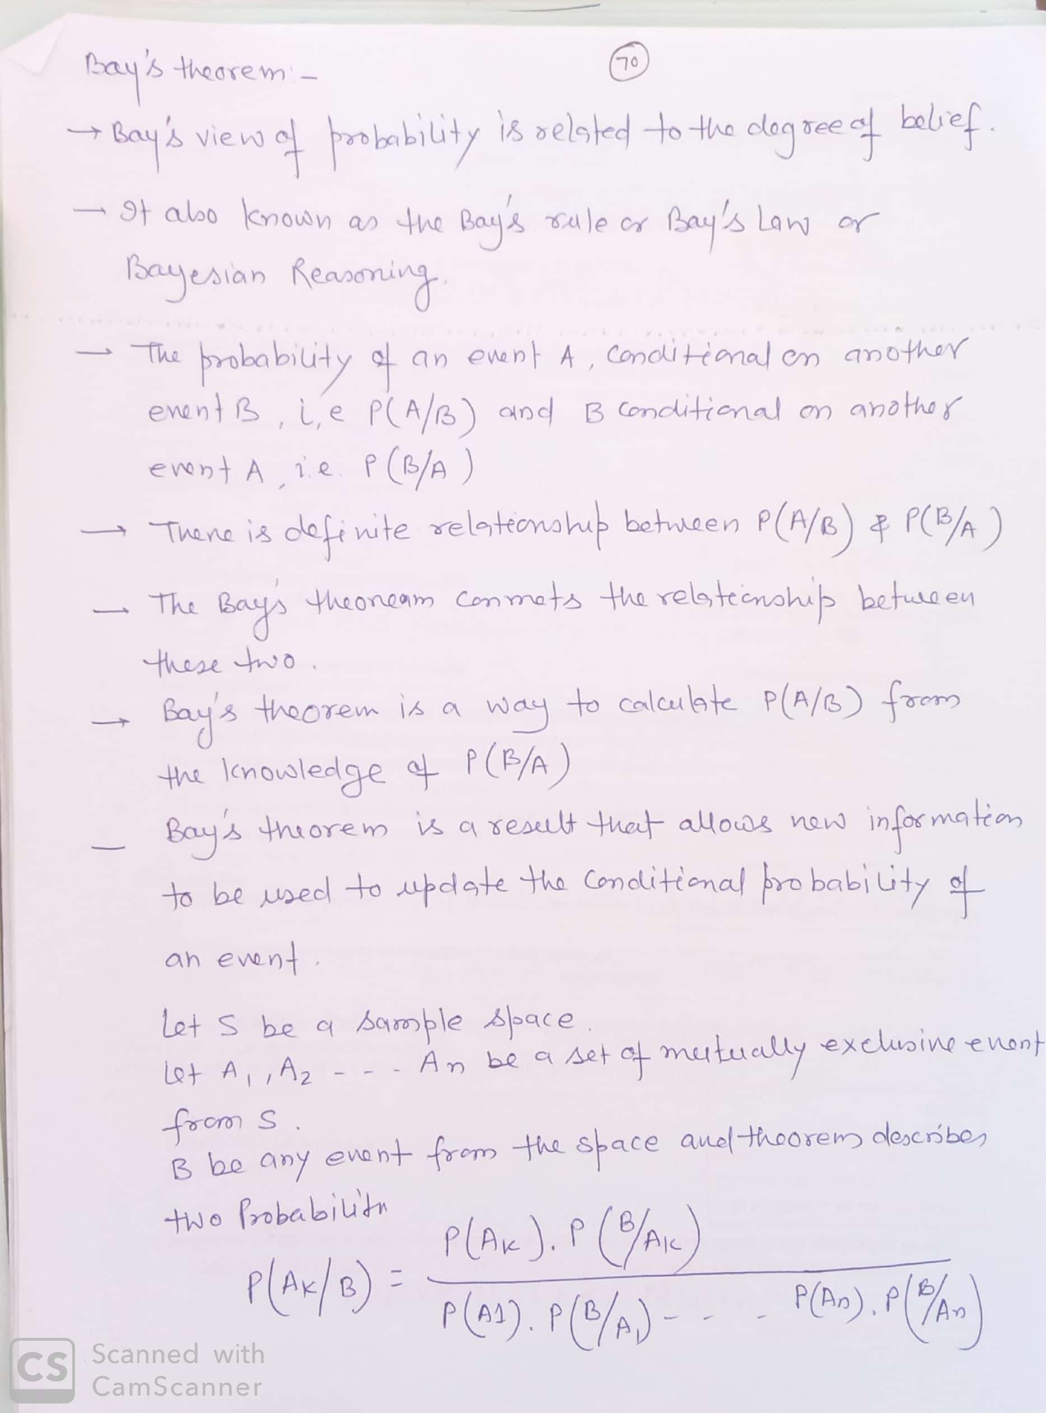
Bay’s Theorem

Slide 14
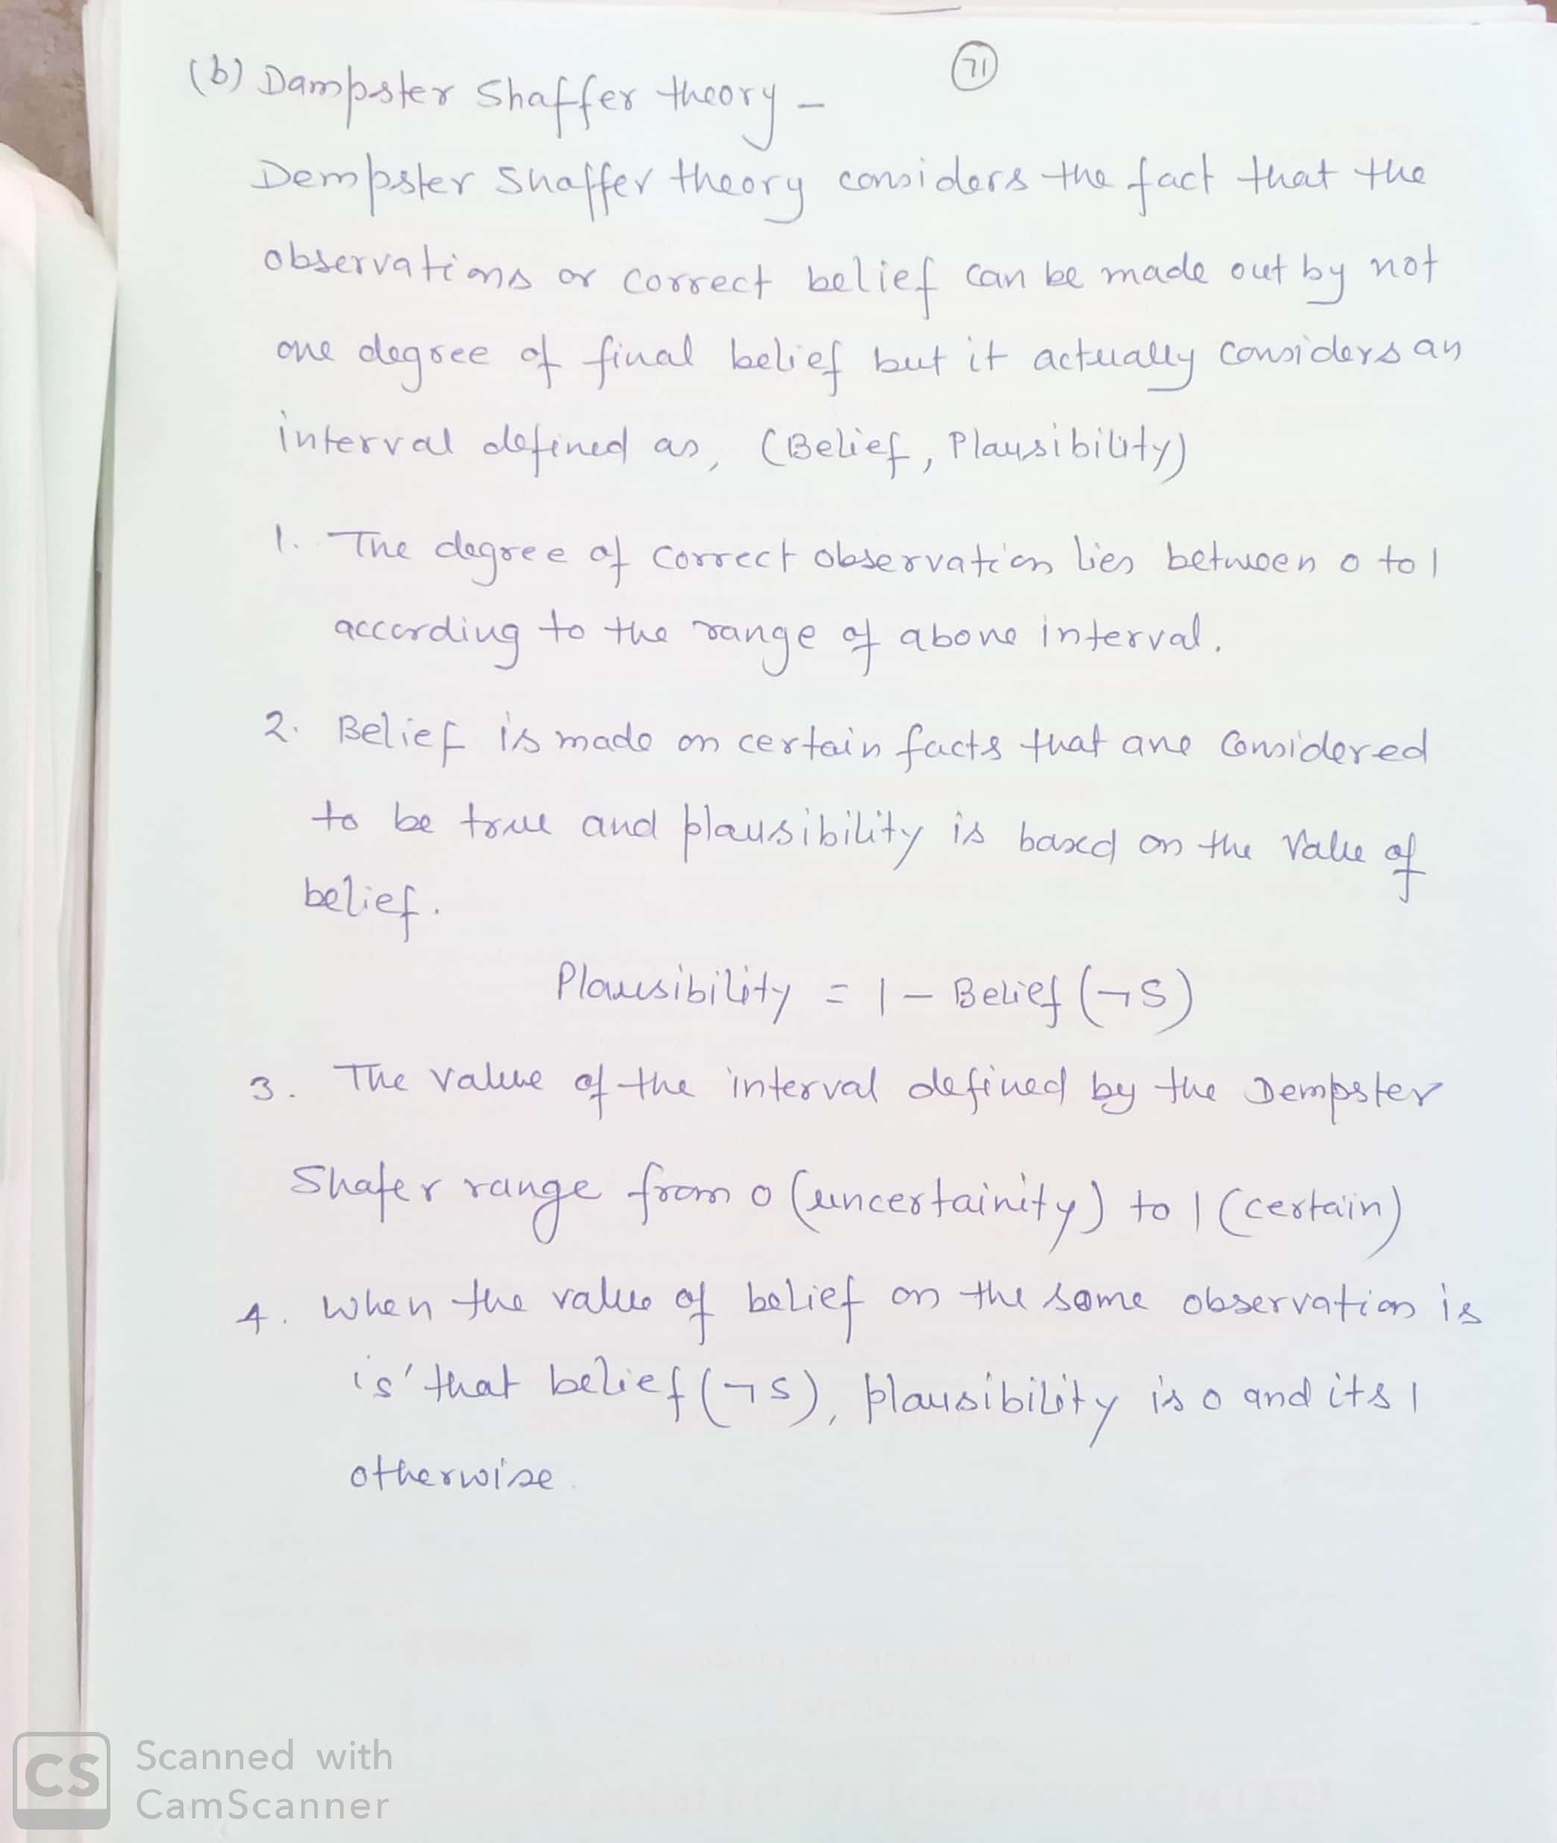
Dampster Shaffer Theory

Slide 15
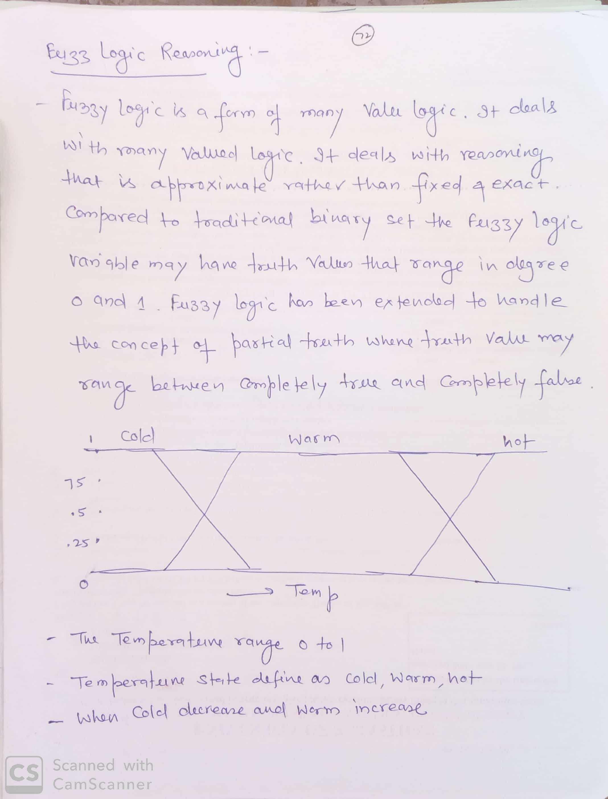
Fuzzy Logics

Slide 16
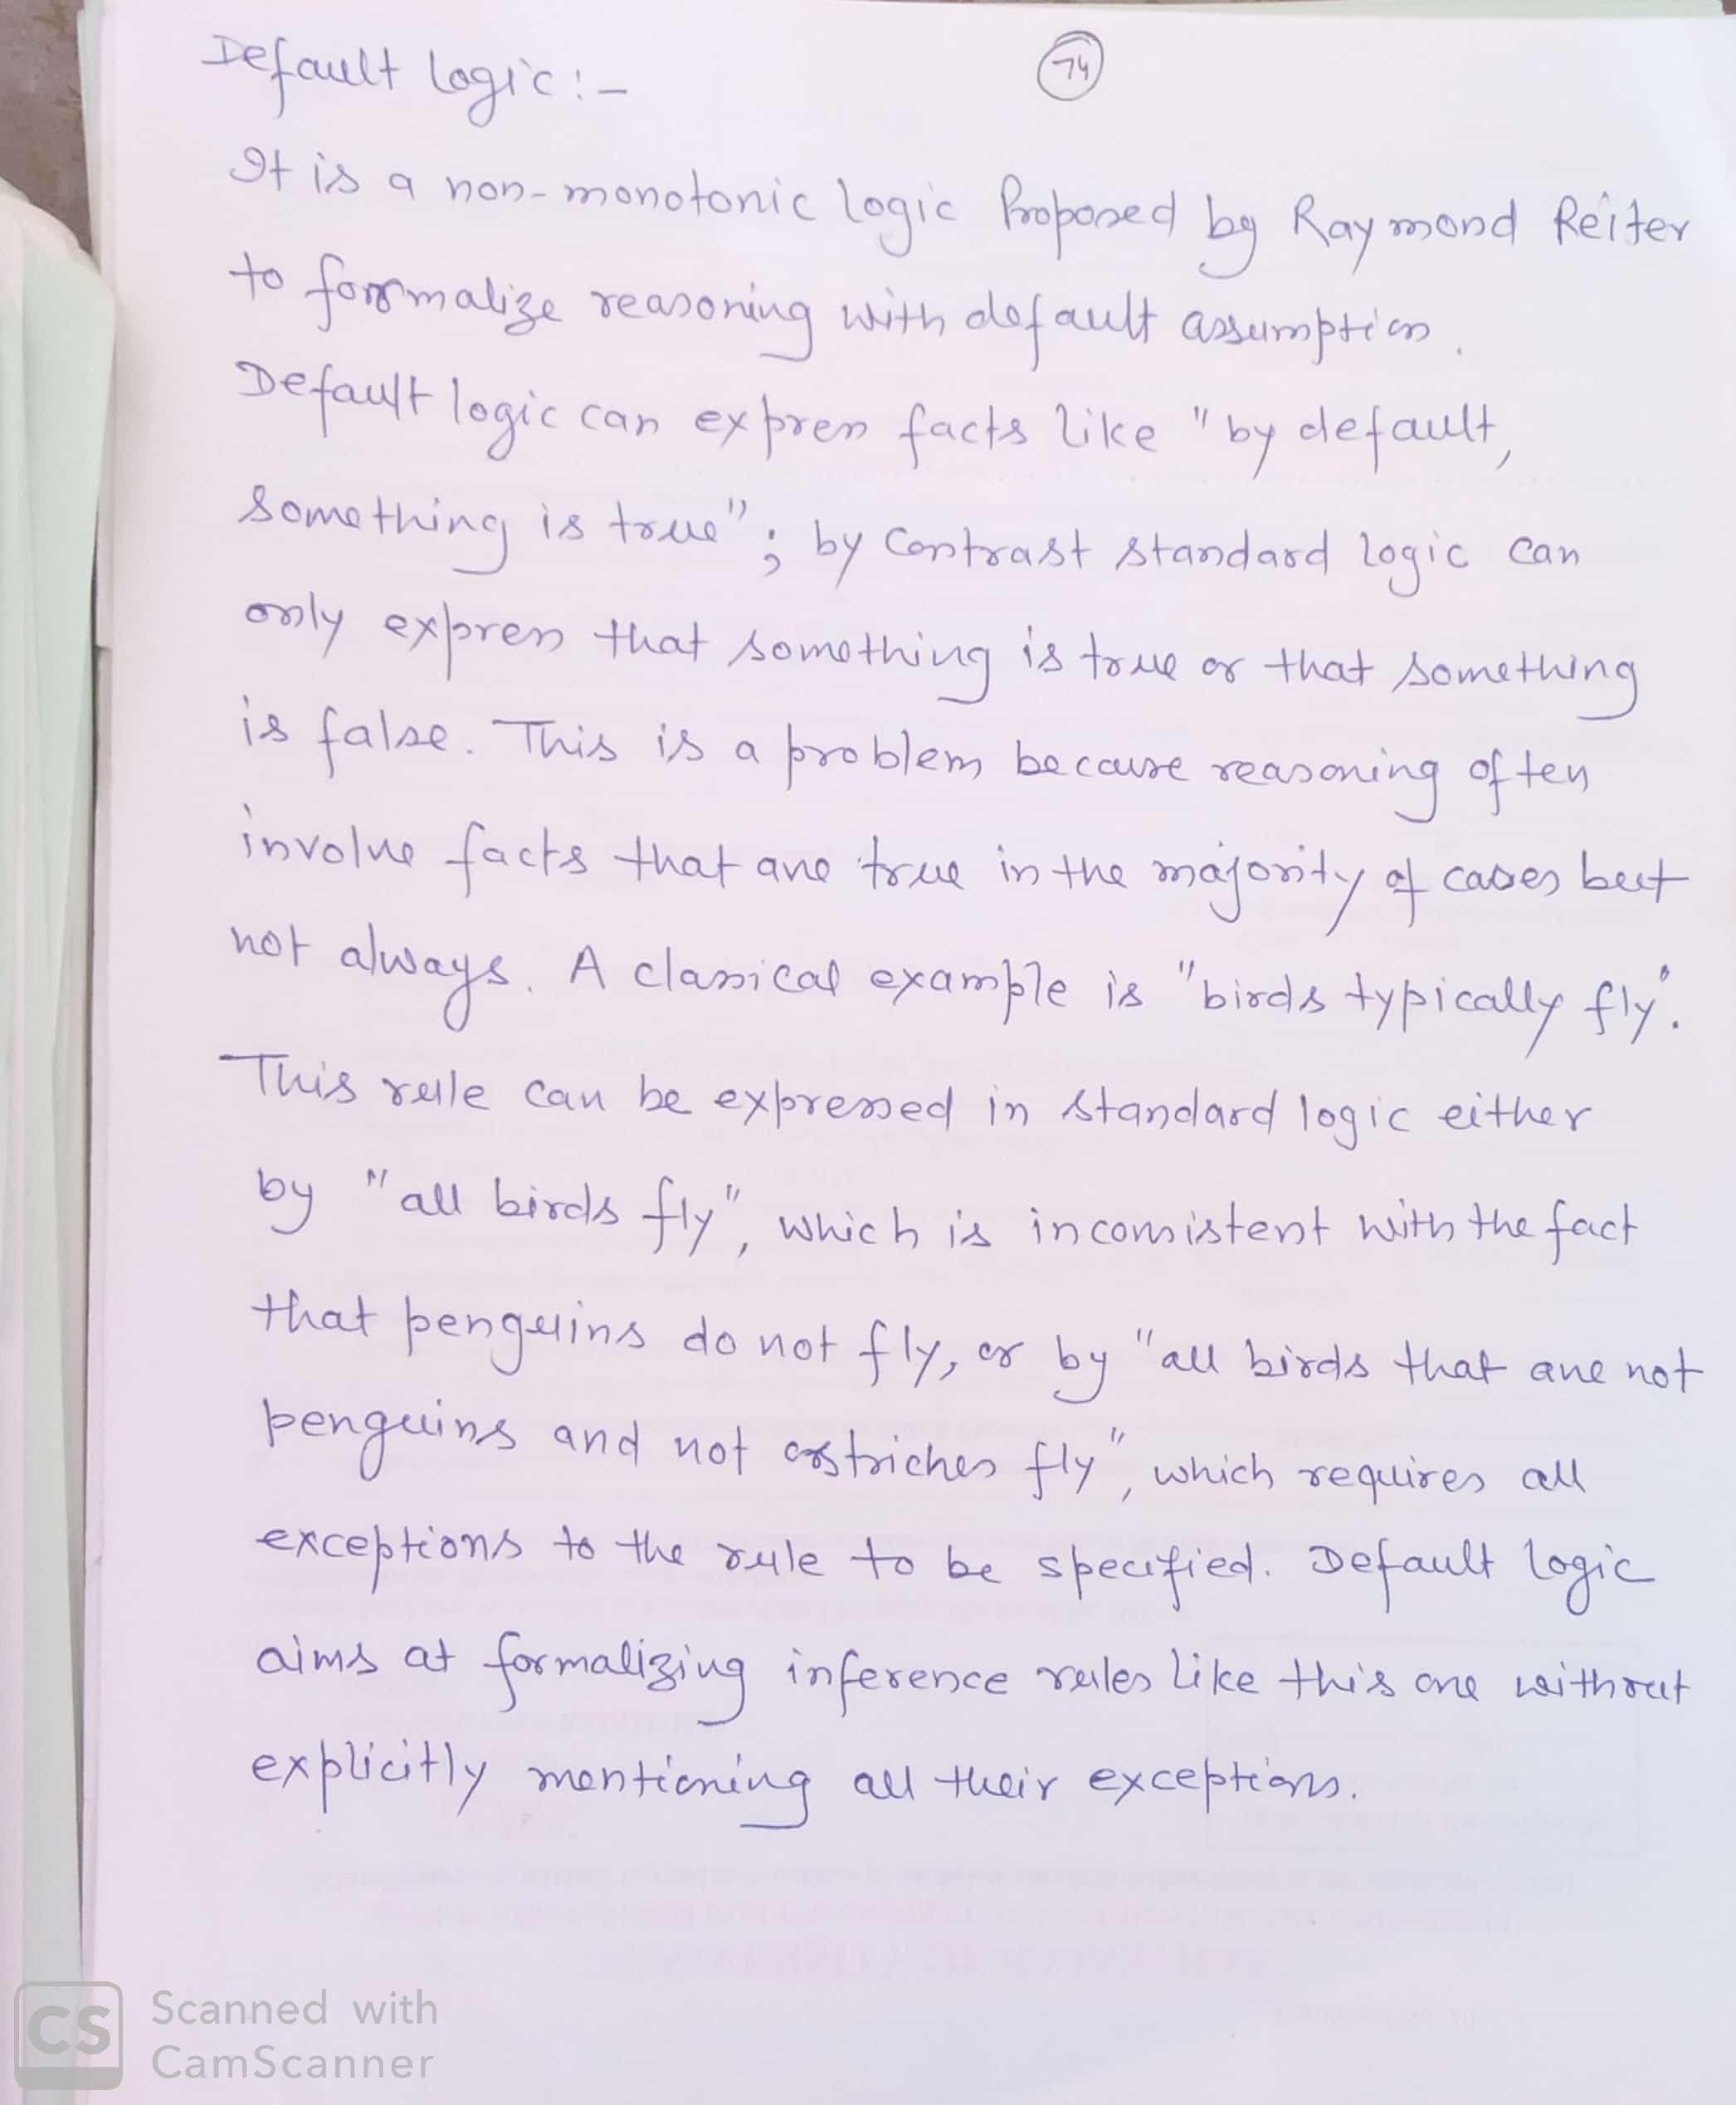
Default Logics

Slide 17
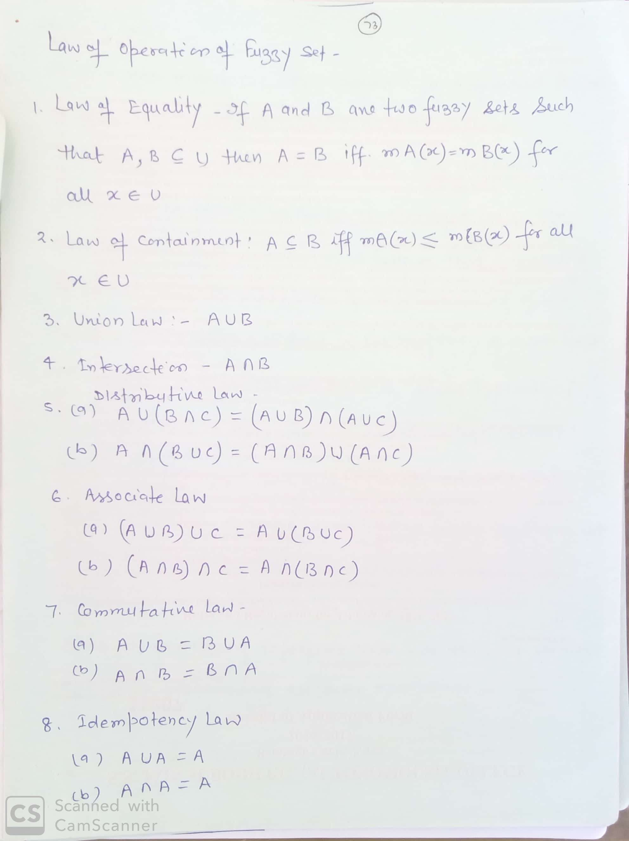

Slide 18
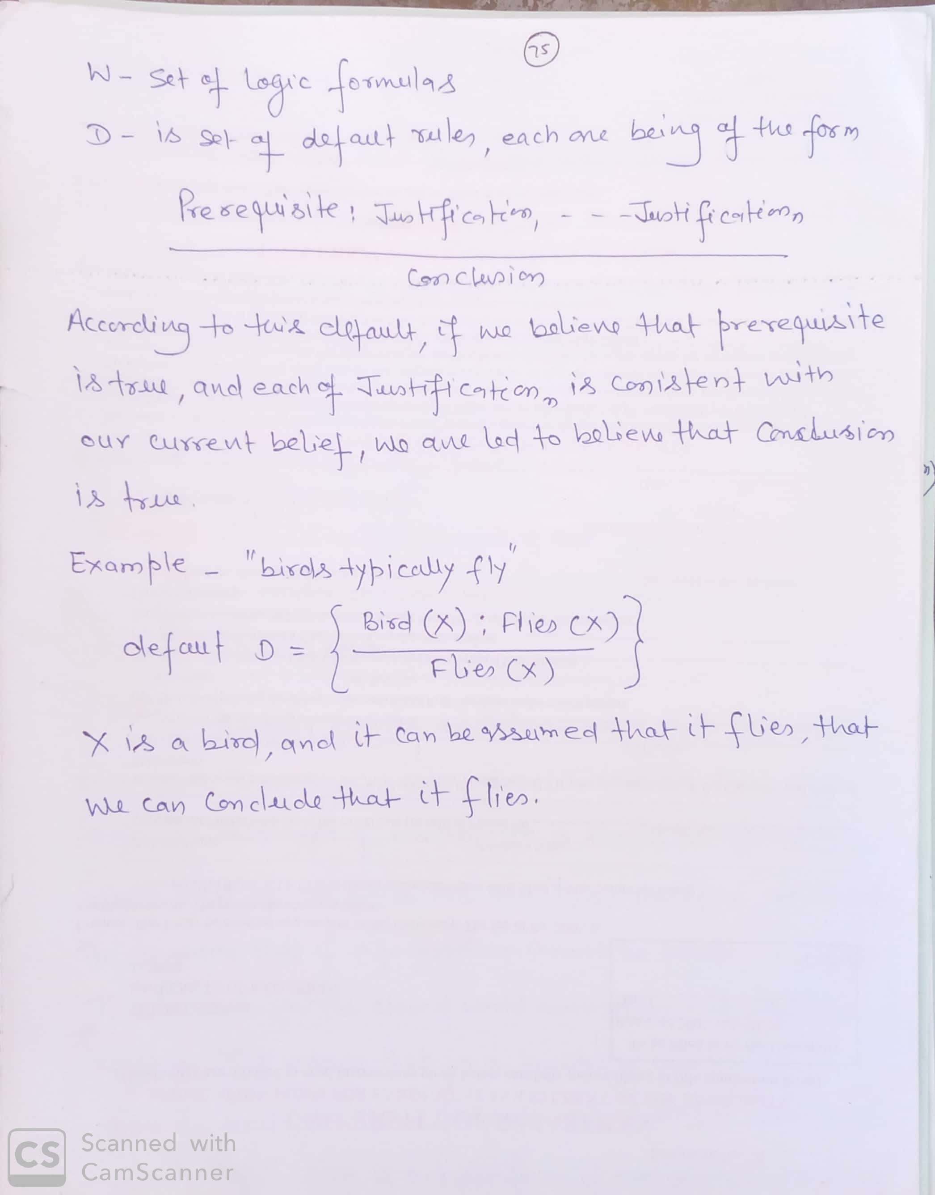

Slide 19
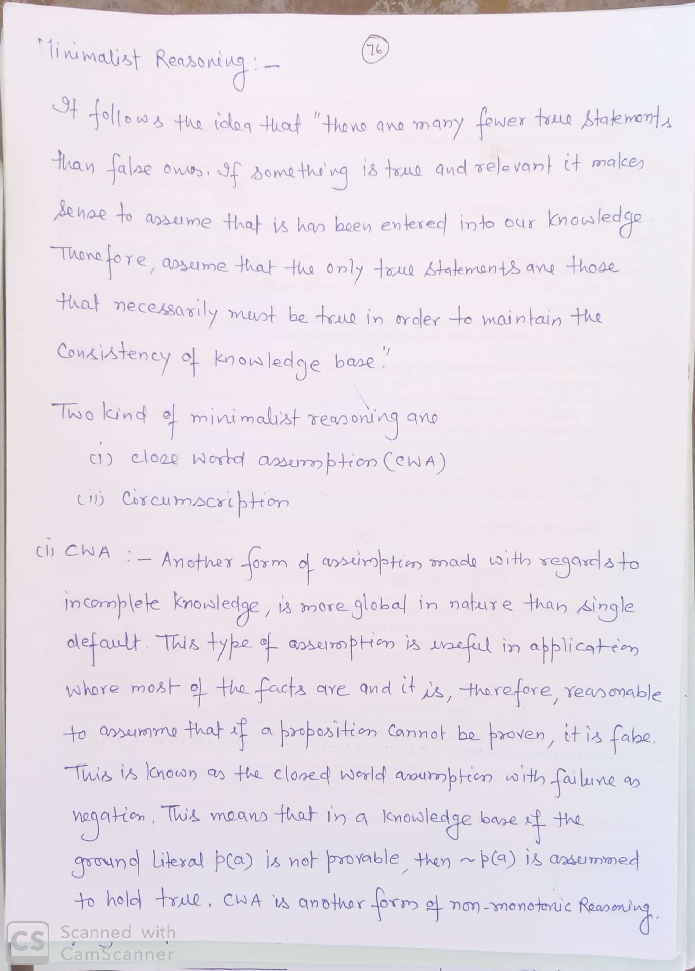
Minimalist Reasoning

Slide 20
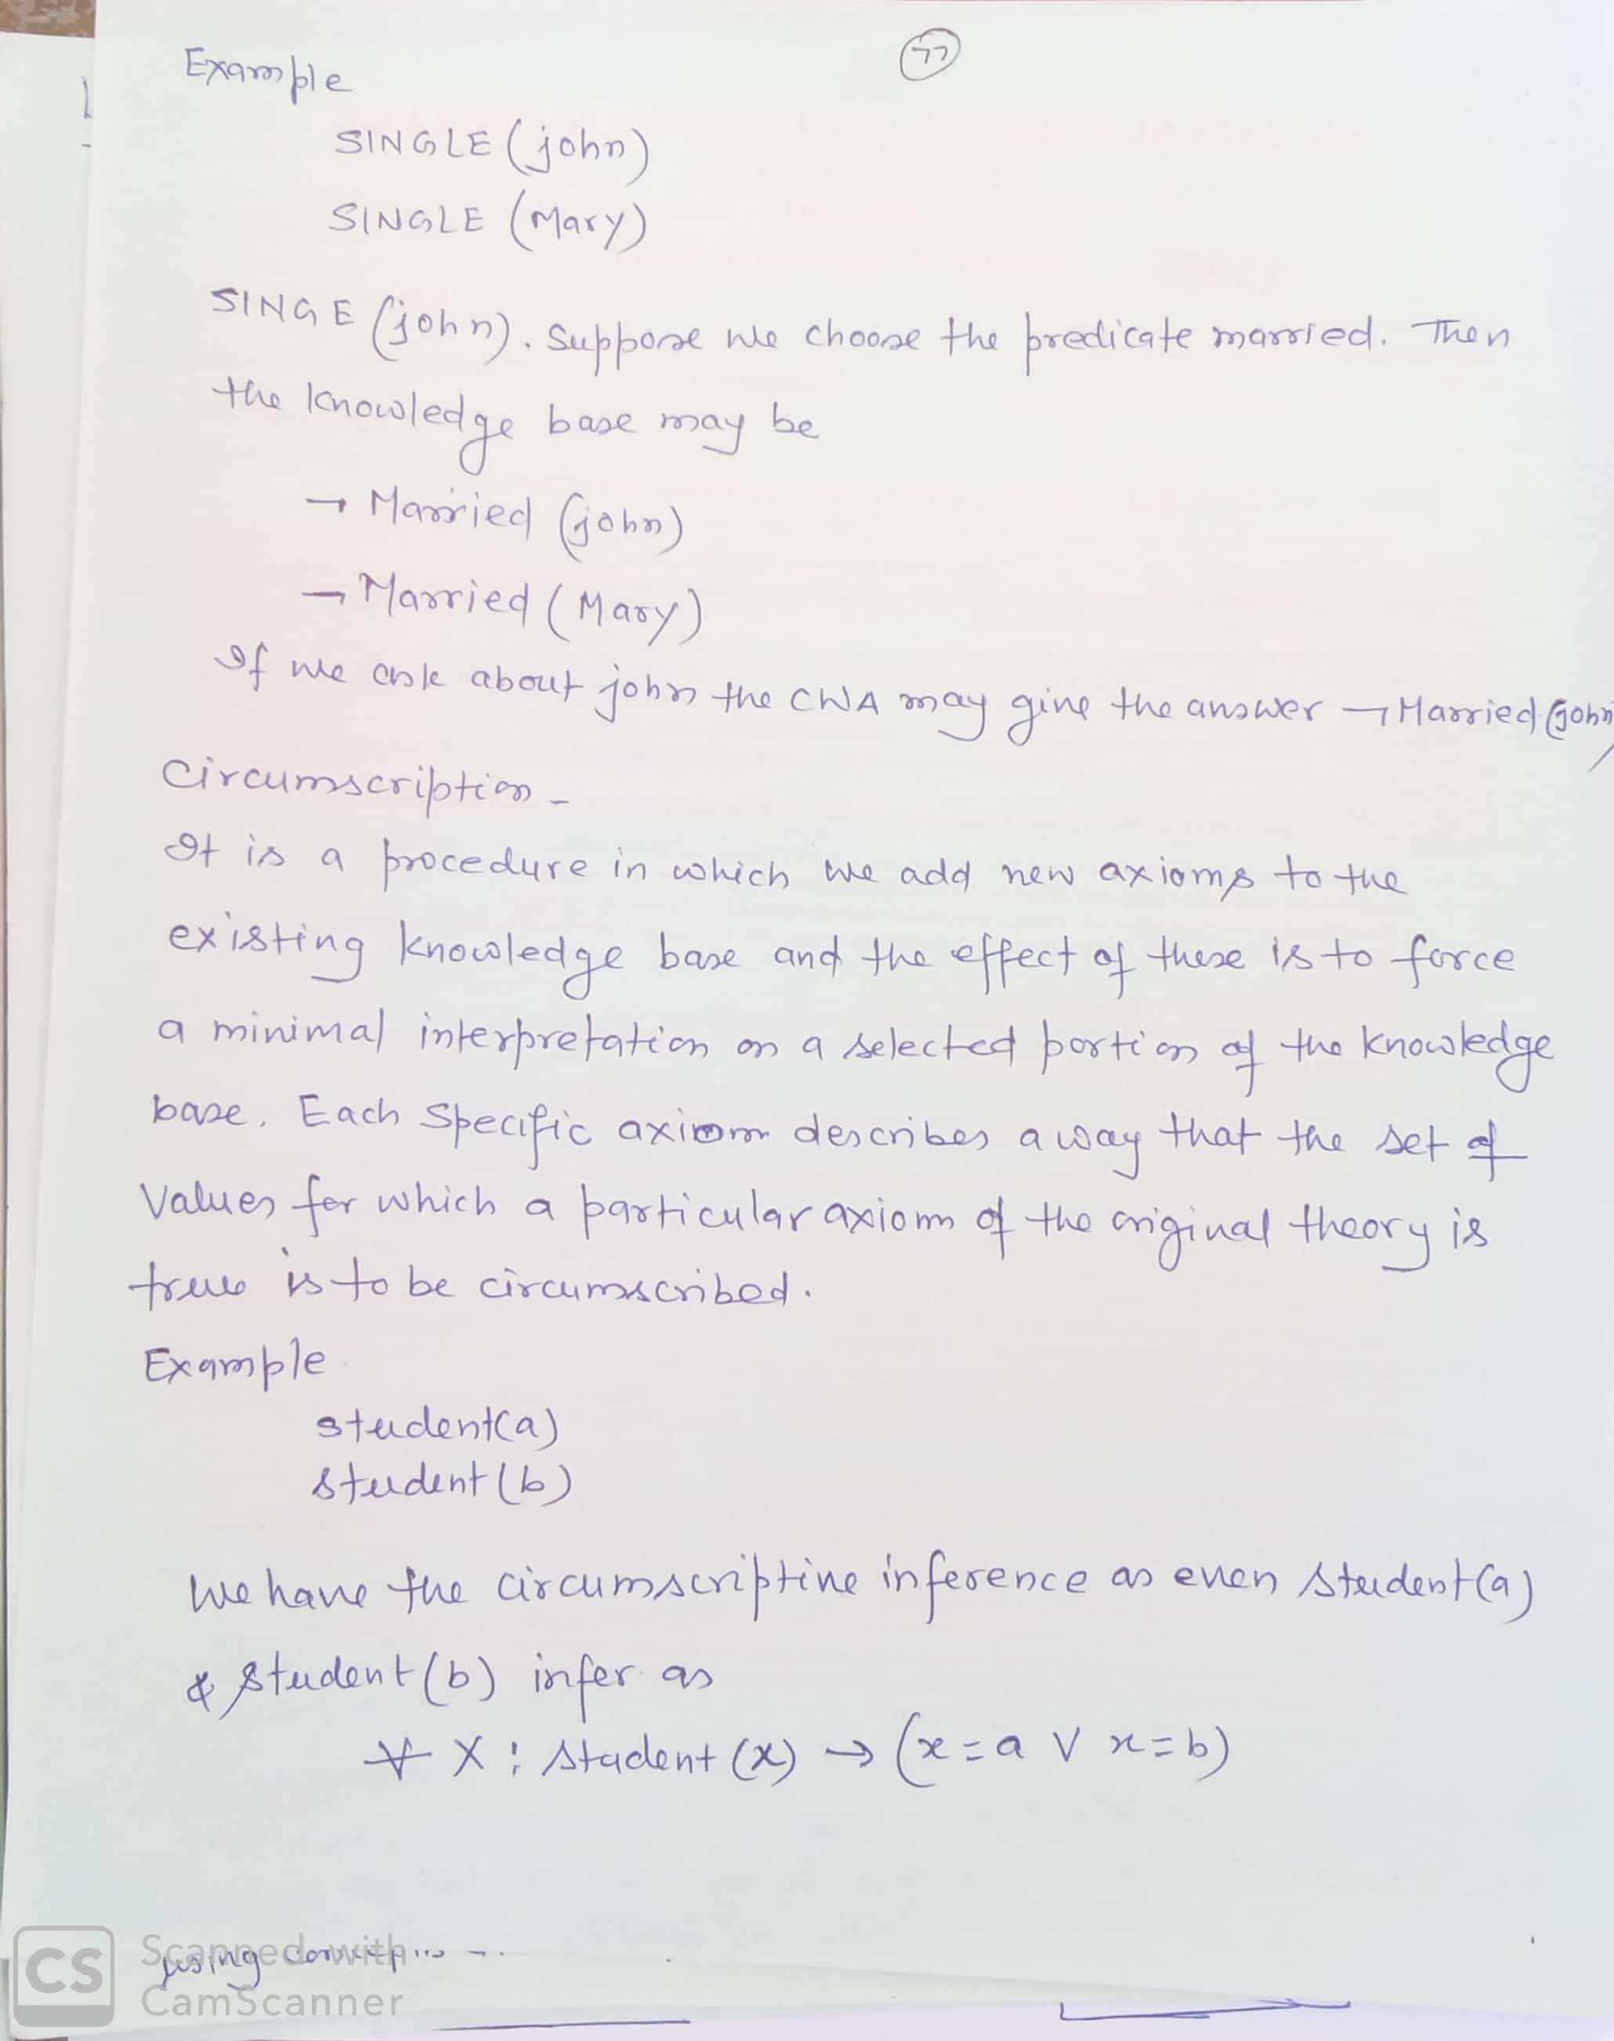

Slide 21
Thanks

